Slide 1
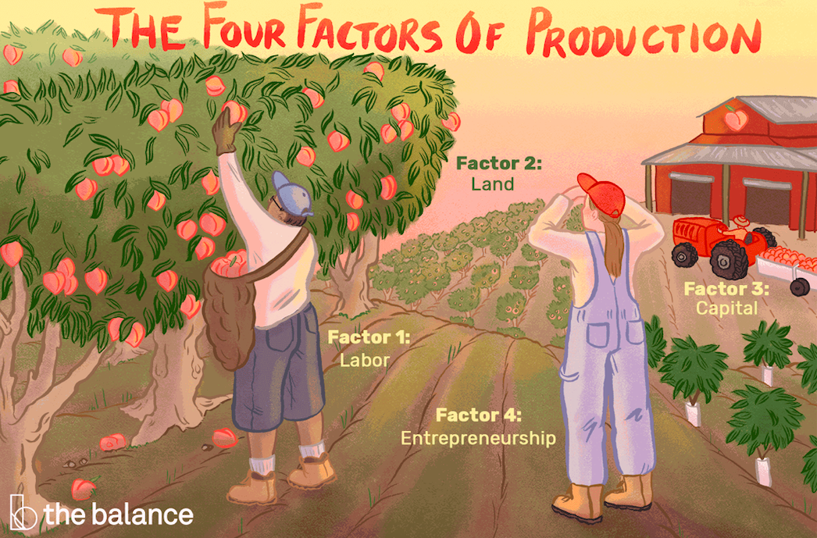
output & costs
Chapter 10

Slide 2
Think like a producer
A firm is an institution that hires factors of production and organizes them to produce and sell goods and services
A firm's fundamental goal is to maximize profit
A producer makes several decisions to achieve its goal
Two different time frames a firm faces for decision-making in terms of output production & cost:
Short run
Long run

Slide 3
Short run
The short run is a time frame in which the quantity of one or more inputs used in production is fixed or cannot be changed instantaneously
Short run decisions are easily reversed
For most firms, inputs such as the capital, called the firm's factory, or technology are fixed in the short run
The cost of the fixed inputs are known as fixed costs (FC)
Other inputs used by the firms (such as labour, raw materials, inputs etc) can be changed in the short run
The cost of the variable inputs are known as variable costs

Slide 4
Long run
The long run is a time frame in which the quantities of all the inputs/ resources can be changed
Long run decisions are not easily reversible
In the long run, fixed costs can change
We’re going to study costs firms face in the short run and the long run

Slide 5
Short run technology constraint
To increase output in the short run, a firm must increase the quantity of labour employed
The relationship between output and the quantity of labour can be described using three concepts:
Total product
Marginal product
Average product
We will look into product schedules or product curves to understand these concepts.

Slide 6
Product schedule
A product schedule shows the total product, marginal product & average product of a firm
Total product is the maximum output that a given quantity of labour can produce
The marginal product of labour is the change in total product resulting from a one-unit increase in the quantity of labour employed, while all other inputs remain same
MP= Change in TP / Change in labour
The average product of labour is equal to total product divided by the quantity of labour employed
AP= Total Product / Total Labour

Slide 7
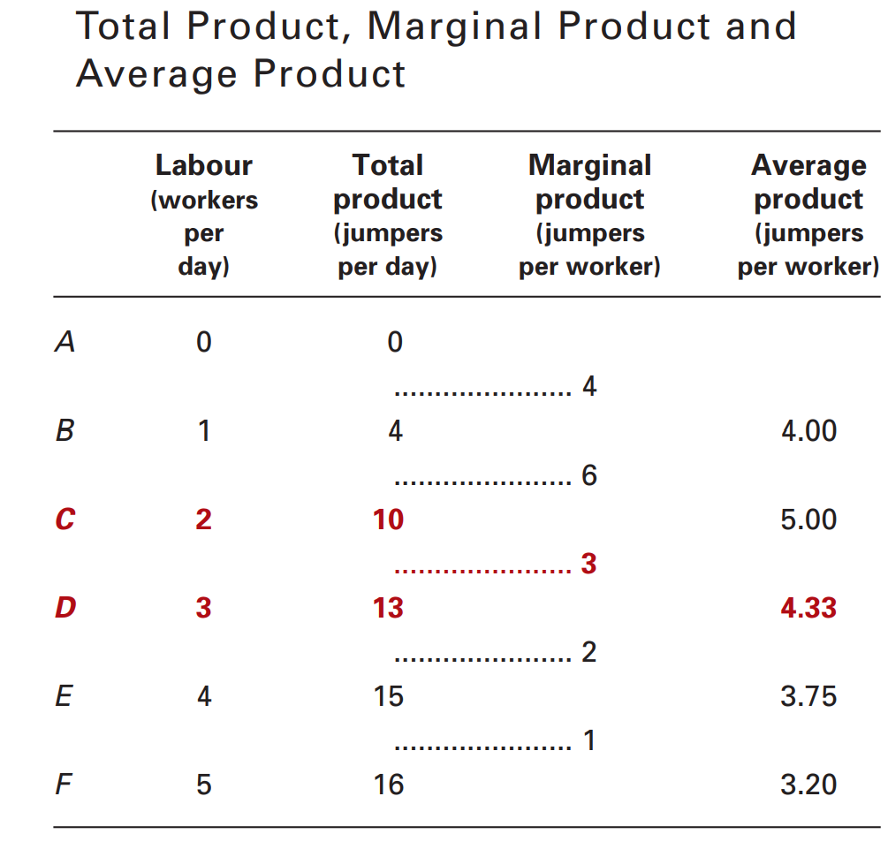
Product schedule
The table tell us how Neat Knits’ production of jumper changes as more workers are employed, for a fixed level of plant and machines. They also tell us about the productivity of Neat Knits’ labour force.

Slide 8
Product curves
The product curves are graphs of the relationships between employment and the three product concepts you’ve just studied
They show how total product, marginal product and average product change as employment changes
They also show the relationships among the three concepts

Slide 9
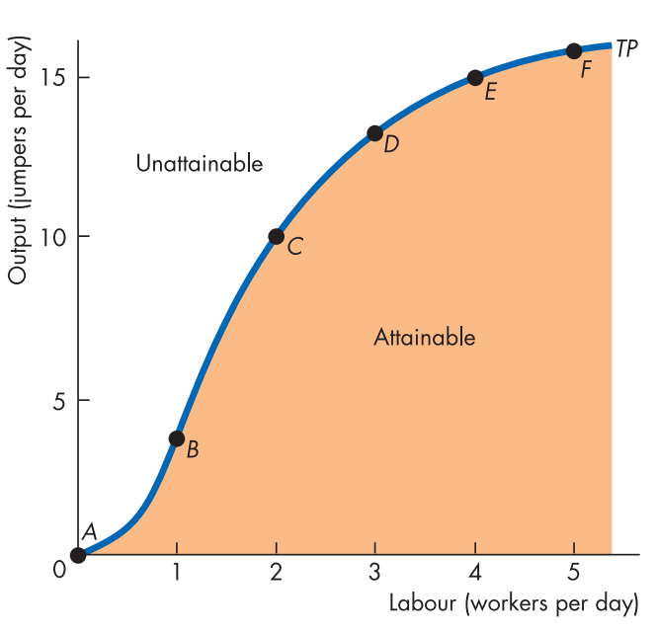
Total product
Production of jumper per day increases as employment increases
Similar to PPF
Points inside the curve are attainable but inefficient
The steepness of the curve increases till point C, then it keeps reducing
The steeper the curve the greater is the marginal product
Slope of the TP curve= Marginal Product

Slide 10
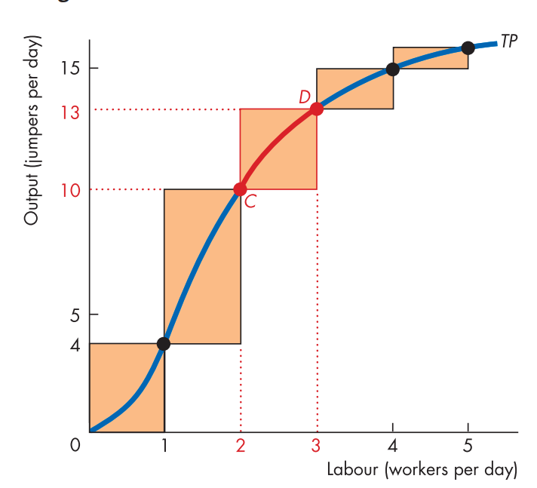
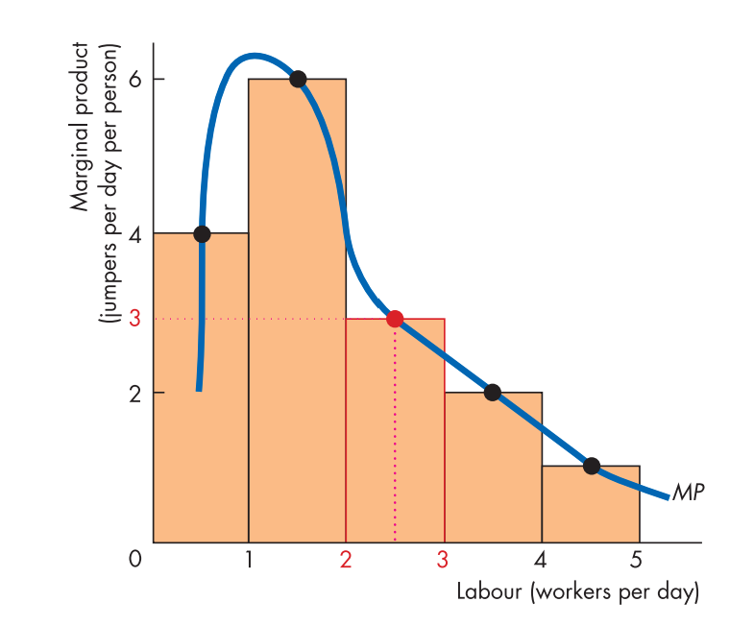
Marginal product
MP shows the output from an additional unit of labour​
Labour can be measured in person, hours or event minutes
The shape of the product curve represents:
- Increasing marginal returns initially
- Diminishing marginal returns eventually

Slide 11
Law of diminishing returns
As a firm uses more of a variable input, with a given quantity of fixed inputs, the marginal product of the variable input eventually diminishes.

Slide 12
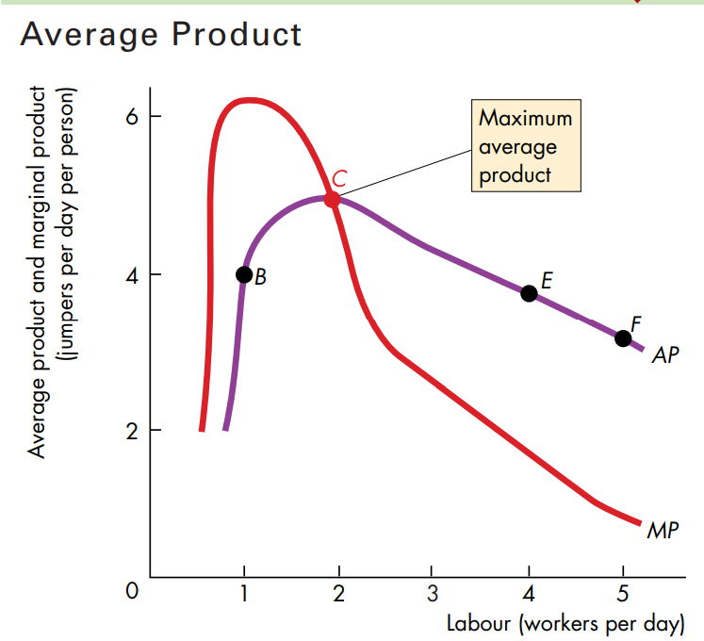
Average product
Average product is largest at the point where MP=AP
AP increases at the points where MP is higher than AP
AP decreases at the points where AP is higher than MP

Slide 13
SHORT RUN COST
To increase output in the short run, the number of labours employed needs to increase
With the increase in labour, cost incurred by the firm also increases
The relationship between output & cost can be described using three concepts:
Total cost
Marginal cost
Average cost

Slide 14
Total cost
Total cost is the sum of the cost of all the factors of production/ inputs used by a firm
Total Cost (TC) is divided in two part:
Total Fixed Cost (TFC)
Total Variable Cost (TVC)
TC= TFC+TVC

Slide 15
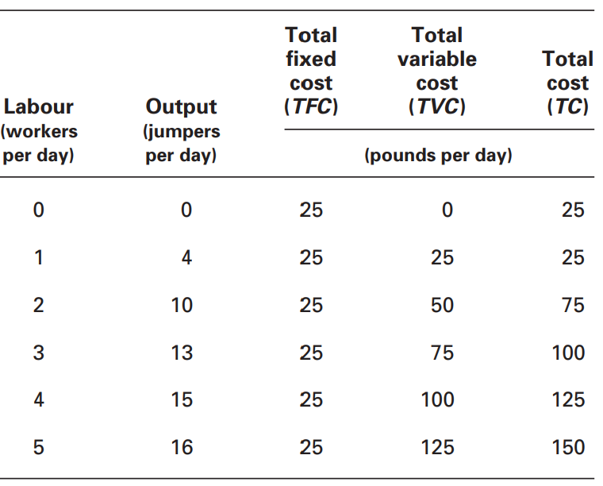
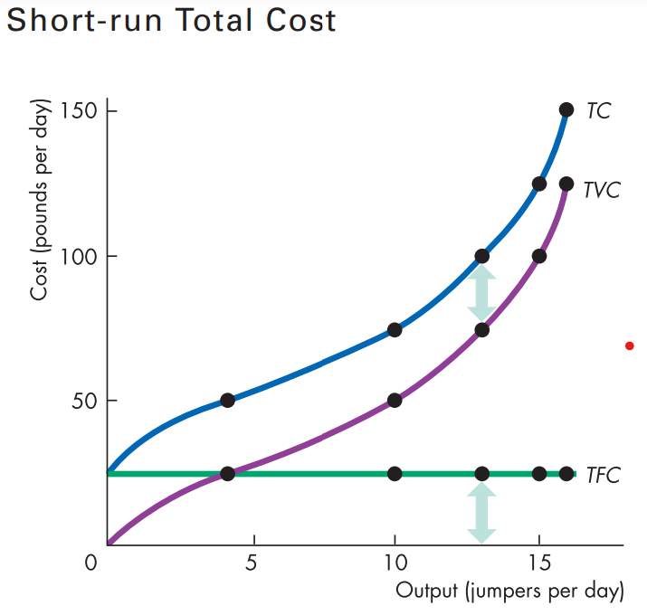

TOTAL COST

Slide 16
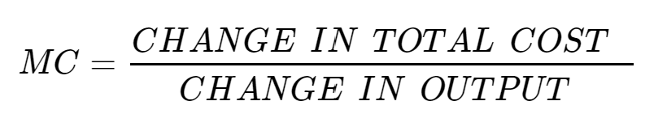
MARGINAL COST
A firm’s marginal cost is the change in total cost resulting from a one-unit increase in output
Marginal cost curve shows how much cost changes as output changes
MC decrease at low level of outputs
MC increases at higher level of outputs because of law of diminishing returns

Slide 17
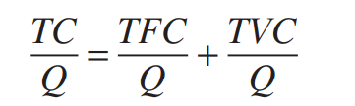
Average cost
Average Cost (AC) is the cost per unit output
Average Cost is divided in three part:
Average Fixed Cost (AFC) is the total fixed cost per unit output
Average Variable Cost (AVC) is the total variable cost per unit output
Average Total Cost (ATC) is the total cost per unit output
OR,
ATC = AVC + AFC

Slide 18
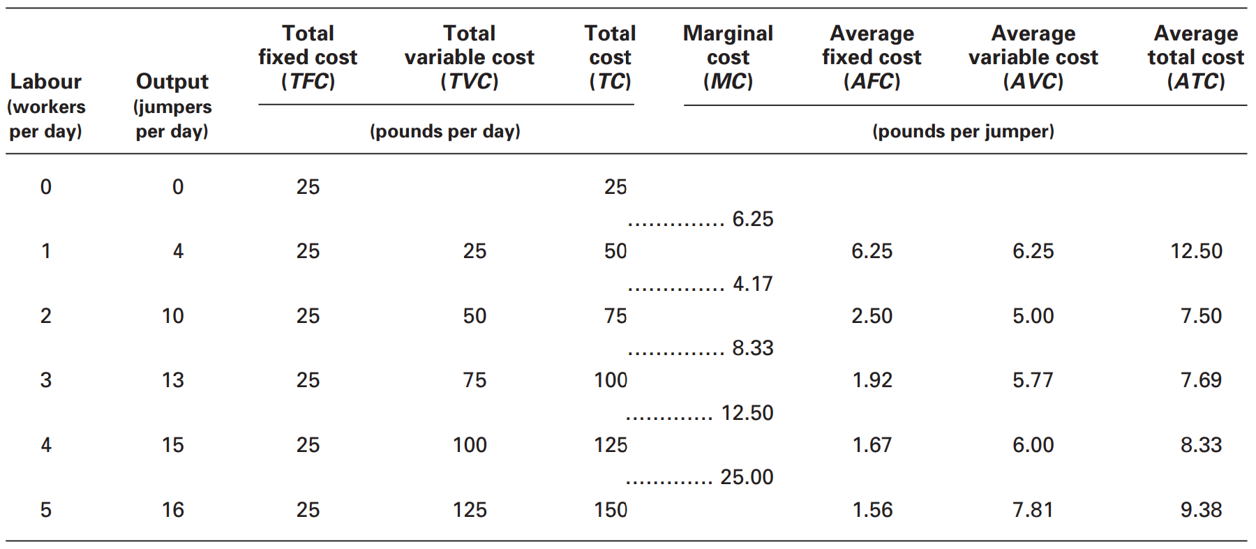

Slide 19
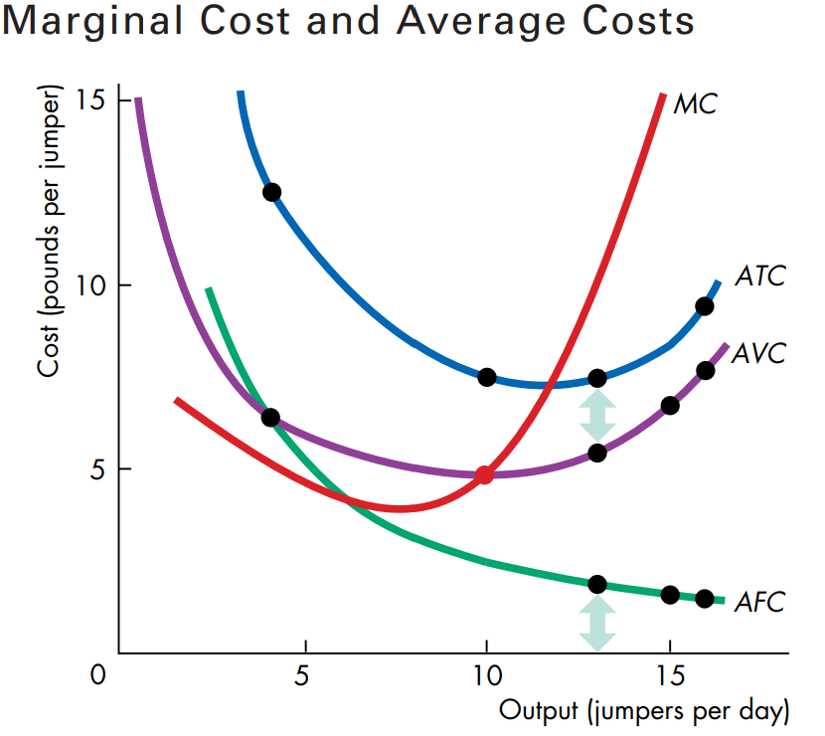
MARGINAL COST & AVERAGE COSTS
The AFC slopes downward. As output increases, the same constant fixed cost is spread over a larger output.
The vertical distance between the ATC & AVC curves is equal to AFC – as indicated by the arrows.
The MC curve intersects the AVC curve and the ATC curve at their minimum point.

Slide 20
WHY IS the aTc CURVE U-SHAPED
The shape of the ATC combines the shape of the AFC & AVC
The U-shape of the ATC arises from the two factors:
Spreading fixed cost over a larger output
Eventually diminishing returns

Slide 21
Cost curves & product curves
A firm’s marginal product curve is linked to its marginal cost curve
If marginal product rises, marginal cost falls.
If marginal product is a maximum, marginal cost is a minimum.
If marginal product diminishes, marginal cost rises.
A firms' average product curve is linked to tis Average Variable Cost curve
If average product rises, average variable cost falls.
If average product is a maximum, average variable cost is a minimum.
If average product diminishes, average variable cost rises.

Slide 22
Long run cost
In the short run, a firm can vary the quantity of labour but the quantity of capital is fixed.
In the long run, the firm can vary both the quantity of labour and the quantity of capital.
We are now going to study the firm’s costs in the long run, when all costs are variable costs and when the quantity of labour and capital vary.

Slide 23
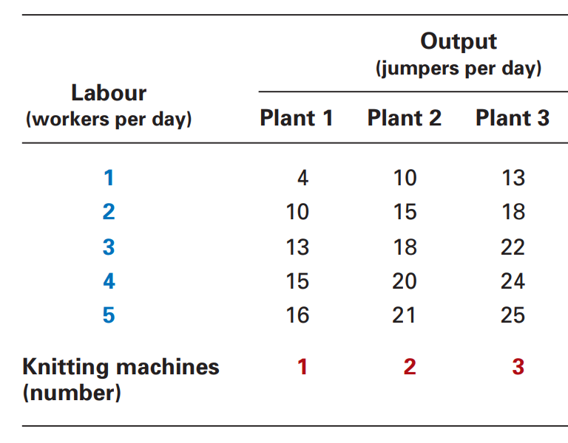
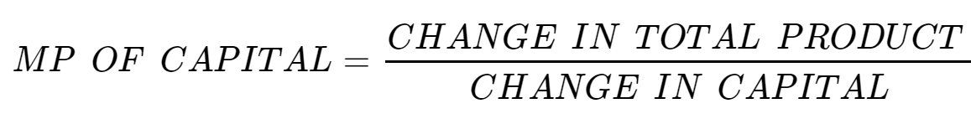
Production function
The table shows Neat Knits’ production function. The table lists the total product for four different quantities of capital.
Diminishing returns occur in all four plants as the labour input increases.
Diminishing Marginal Product of Capital

Slide 24
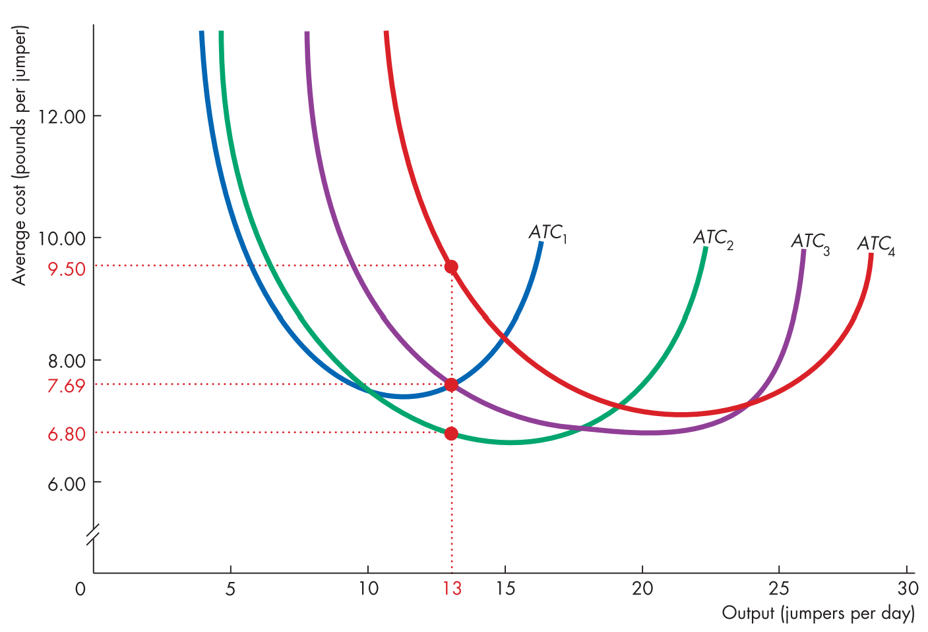
SHORT RUN COST ON fOUR DIFFERENT PLANTS
The figure shows short-run average total cost curves for four different quantities of capital.
Two things stand out:
Each short-run ATC curve is U-shaped.
For each short-run ATC curve, the larger the plant, the greater is the output at which ATC is a minimum.

Slide 25
LONG RUN AVERAGE COSTS
The plant size determines the short-run average cost curve on which Neat Knits operates
The plant size is determined by the owner. The owner's choice of plant size depends on the output he/ she plans to produce.
The average total cost of producing a given output depends on the plant size. Example: suppose that Sam plans to produce 13 jumpers a day. Check graph.
In the long run, Neat Knits chooses the plant size that minimizes average total cost.
For a given output, a firm operates on its long-run average cost curve.
The long-run average cost curve is the relationship between the lowest attainable average total cost and output when both the plant size and labour are varied.

Slide 26
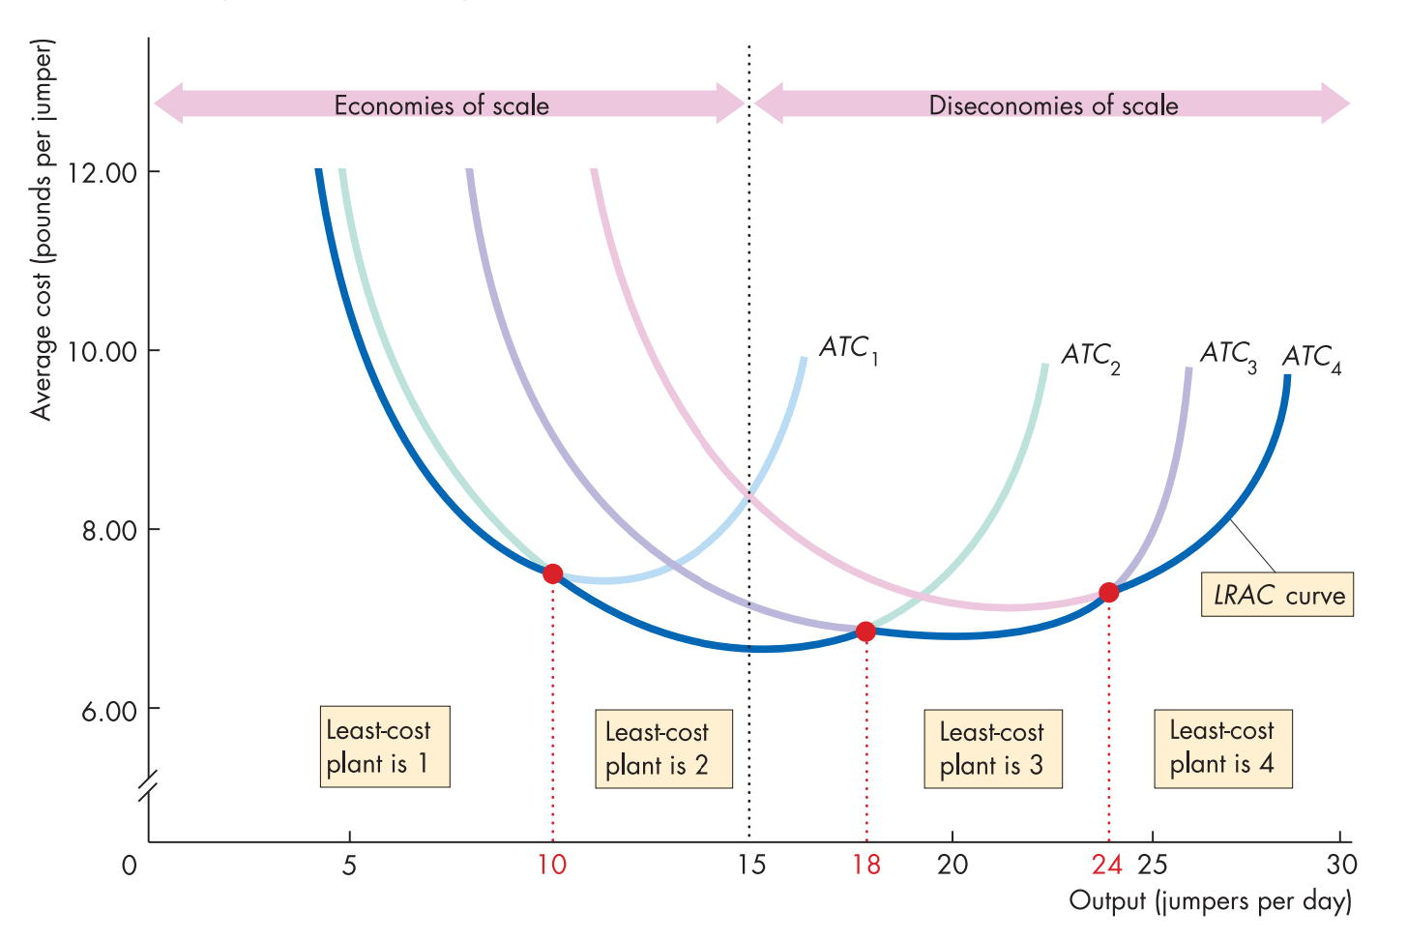
LONG run average cost curve
When economies of scale are present, the LRAC curve slopes downward
If economies of scale are present, when a firm doubles all inputs, its output will more than double, and so average costs fall
When diseconomies of scale are present, the LRAC curve slopes upward

